Slide 1
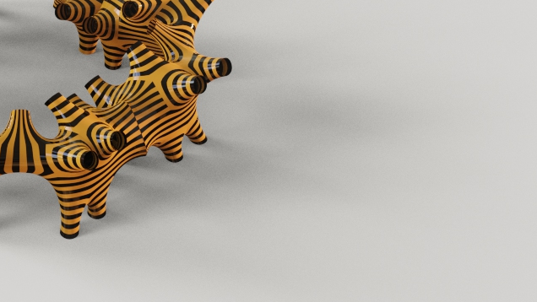

Software I - inFORMed geometries
IaaC, 18/11/2021
Faculty / Andrea Graziano
Assistant / Eugenio Bettucchi
MRAC
Master in Robotics and Advanced Construction
Christopher Booth
Jordi Vilanova
Ipek Attaroglu
Names

Slide 2
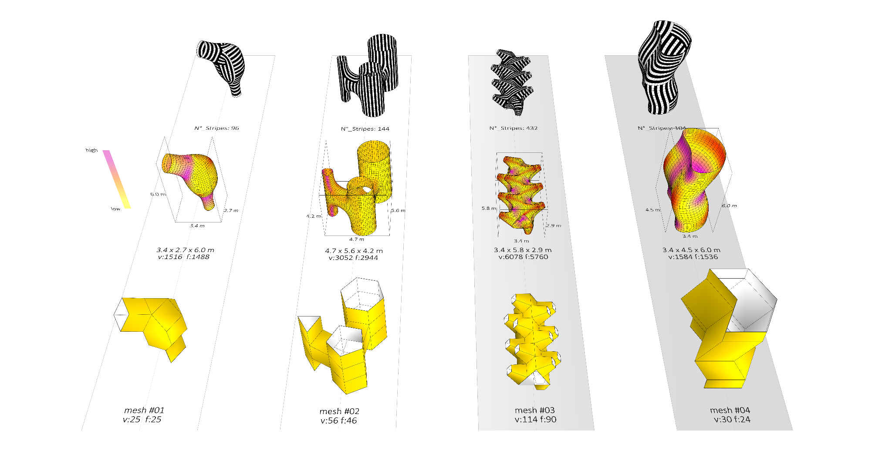
Mesh Geometries

Slide 3
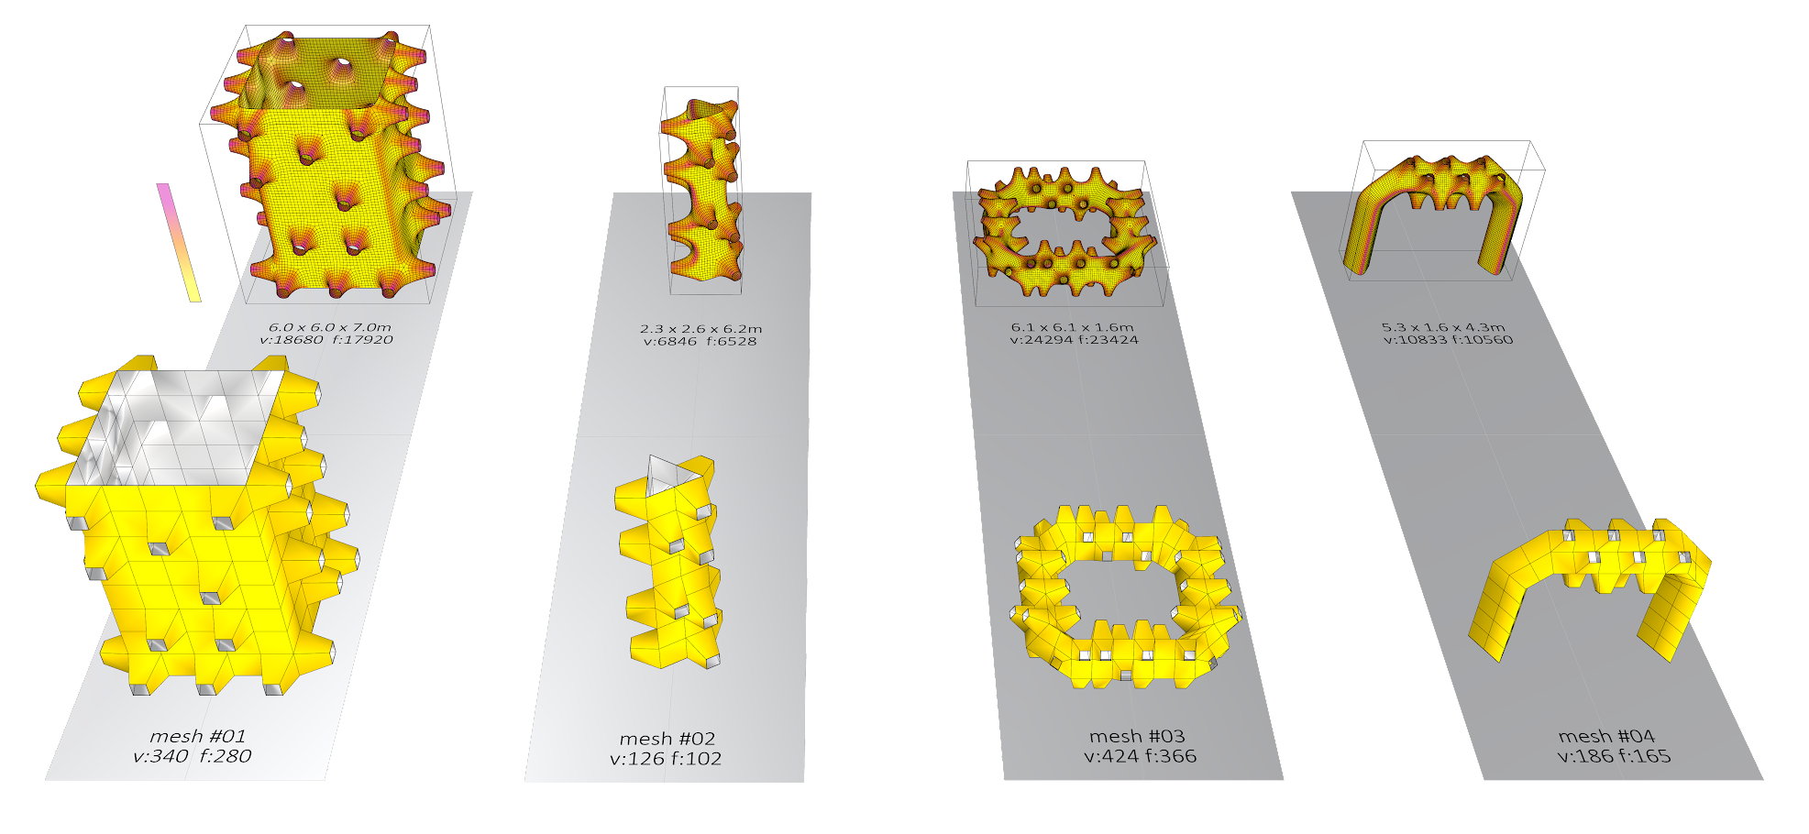
Initial Mesh Geometries
Explored 2
Notes:
We liked the effect that holes make and decided to continue with options including quite a lot of holes arranged in an asymmetrical way.
We found that this quantity of faces and holes becomes difficult to manage efficiently.
We decided we wanted a simplified version of this model...
We had a lot of difficulty managing the orientation of the stripes on a ‘simplified’ model which still had over 160 faces.
Although the faces numbers and vertex arrangement could be shown, manipulating the faces to reorient them was still very difficult.

Slide 4
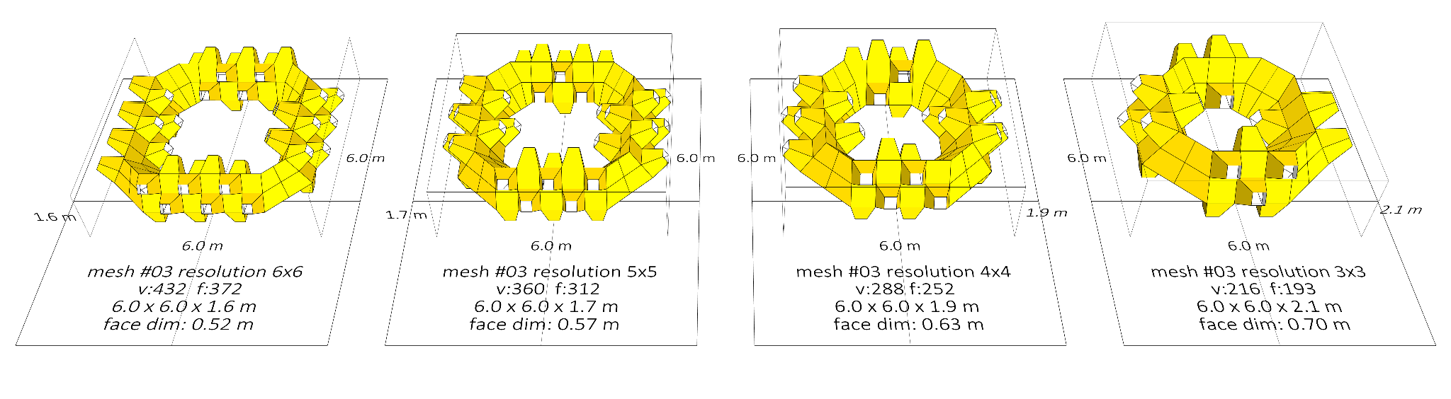
Mesh ‘Resolution’ (i.e. Quantity of mesh elements on sides and corners)

Slide 5
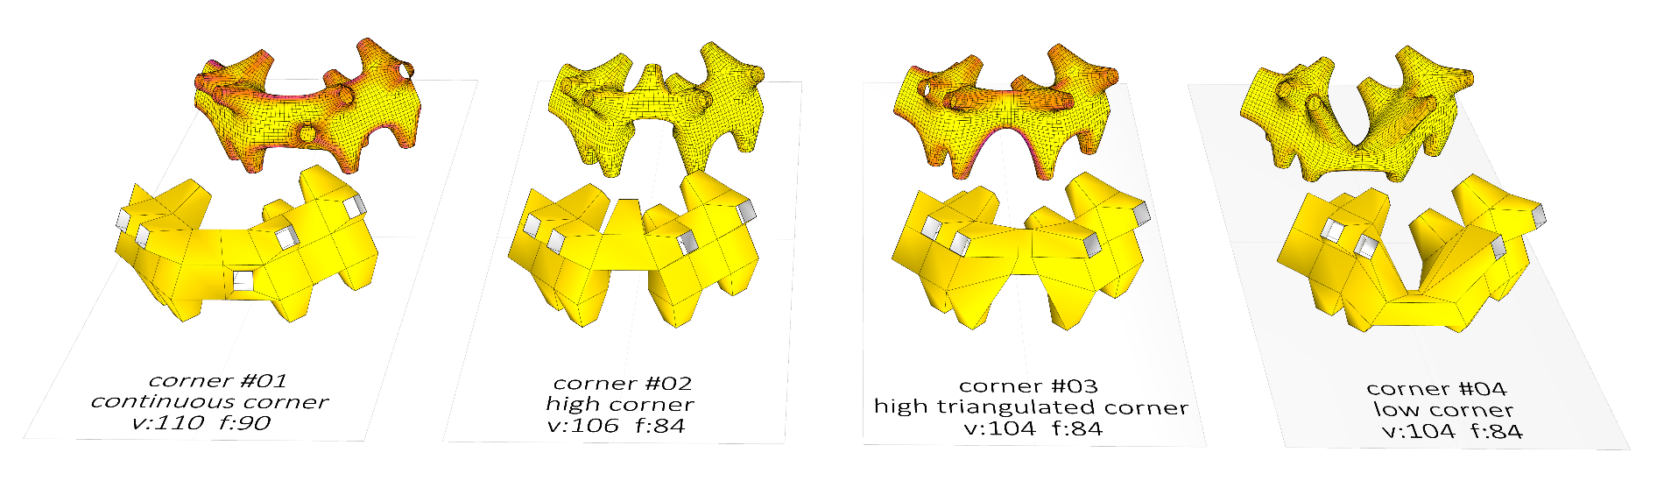
Mesh Development

Slide 6
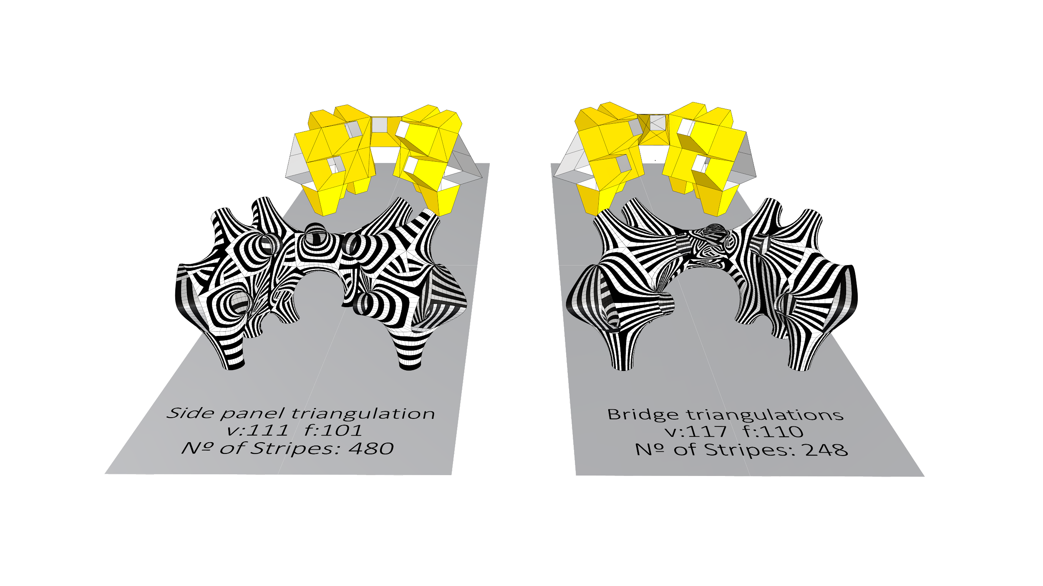
Mesh topologies

Slide 7
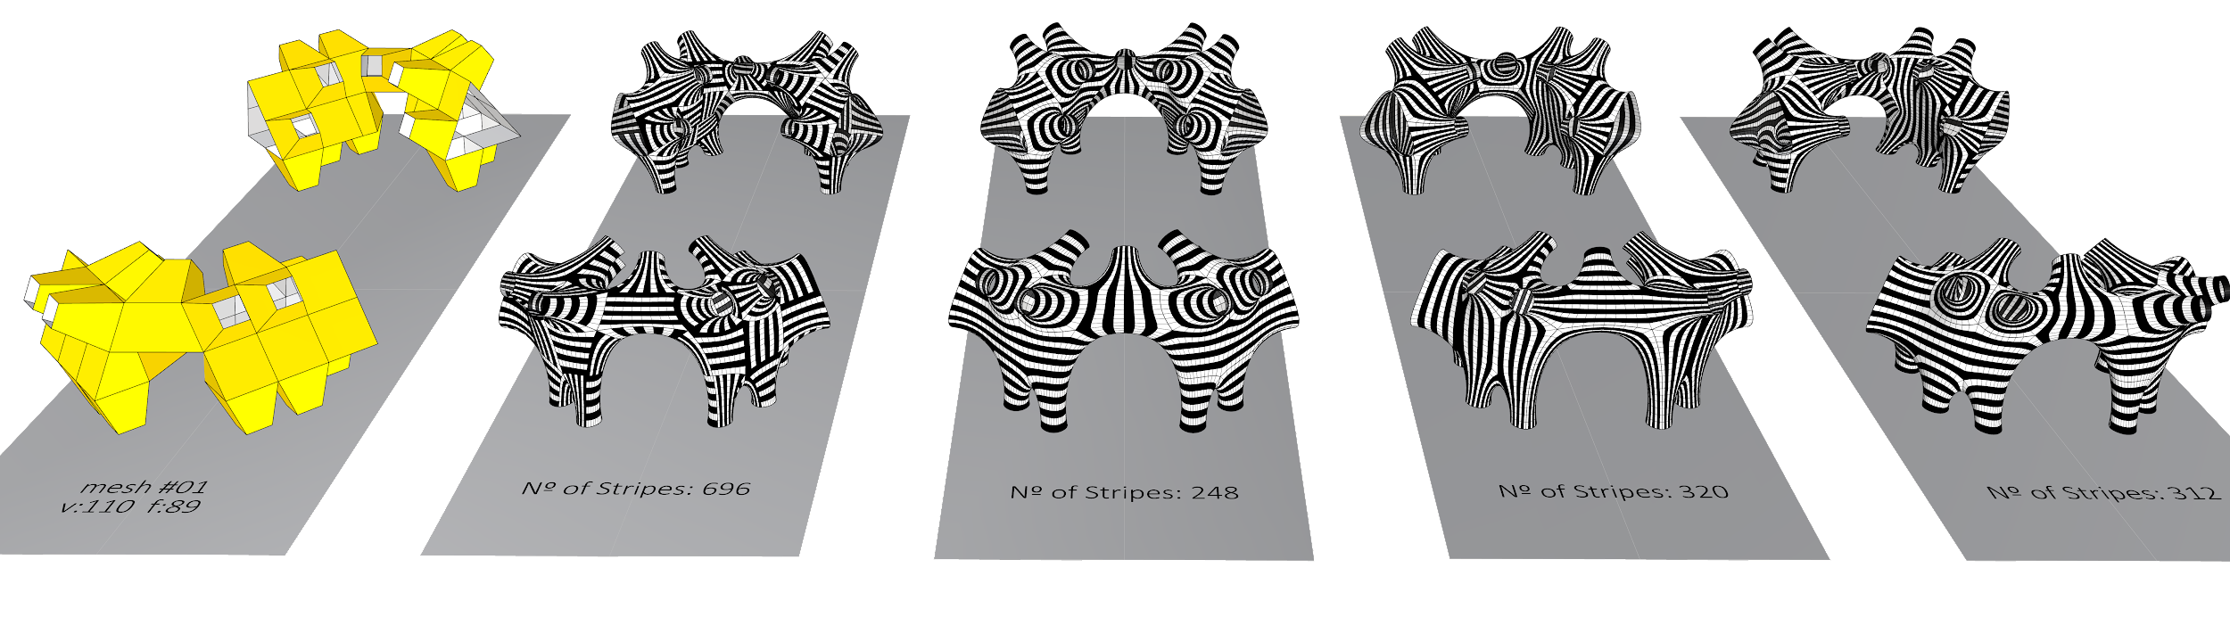
Mesh face topologies
b a c k
f r o n t

Slide 8
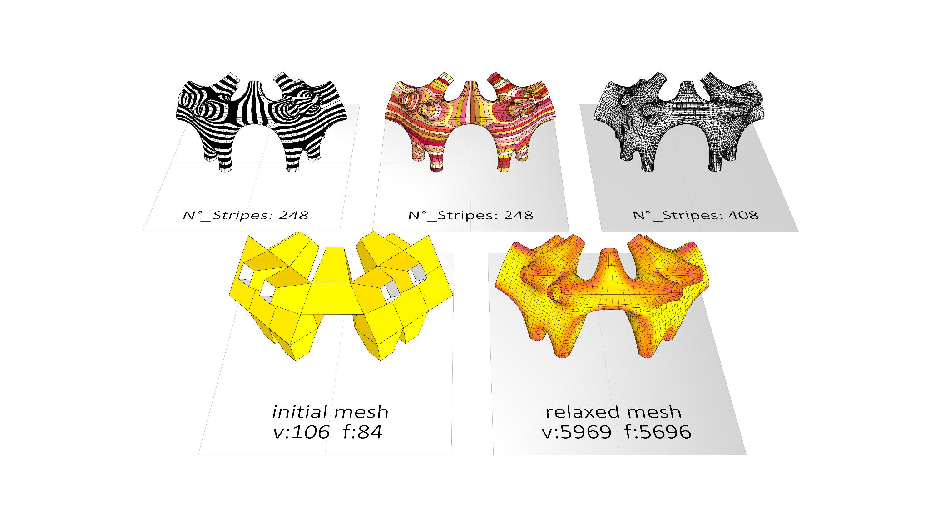
Stripper, Warp & Weft

Slide 9
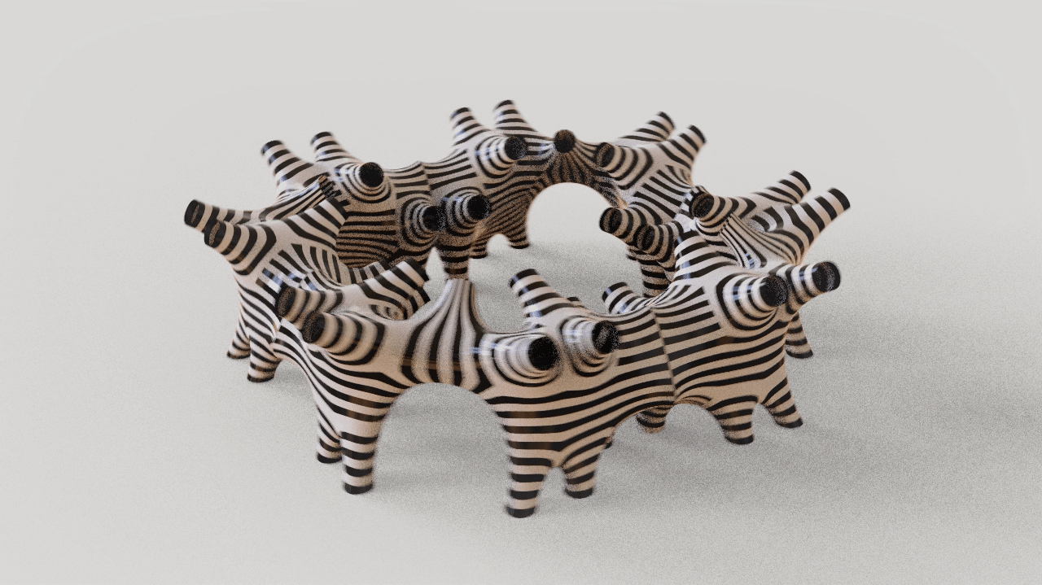

Desired configuration

Slide 10
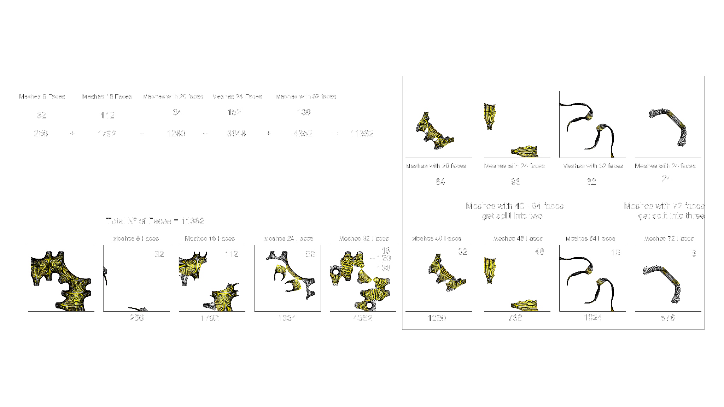
Material
Cold Rolled Stainless Steel Sheets
0.53 mm
1.5 x 3 m
4.92 kg/m2
N°_sheets: approx. 80 - 90
total weight: approx. 1700 - 1900 kg
h: 5150 mm
w: 4000 mm
d: 1500 mm

Slide 11
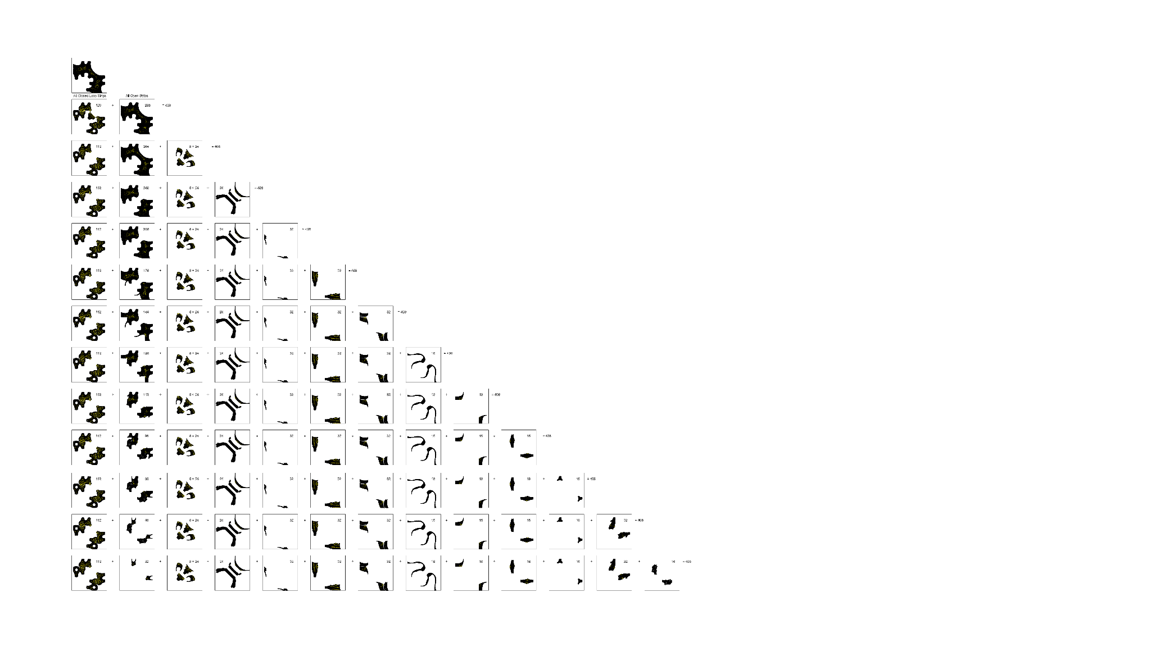
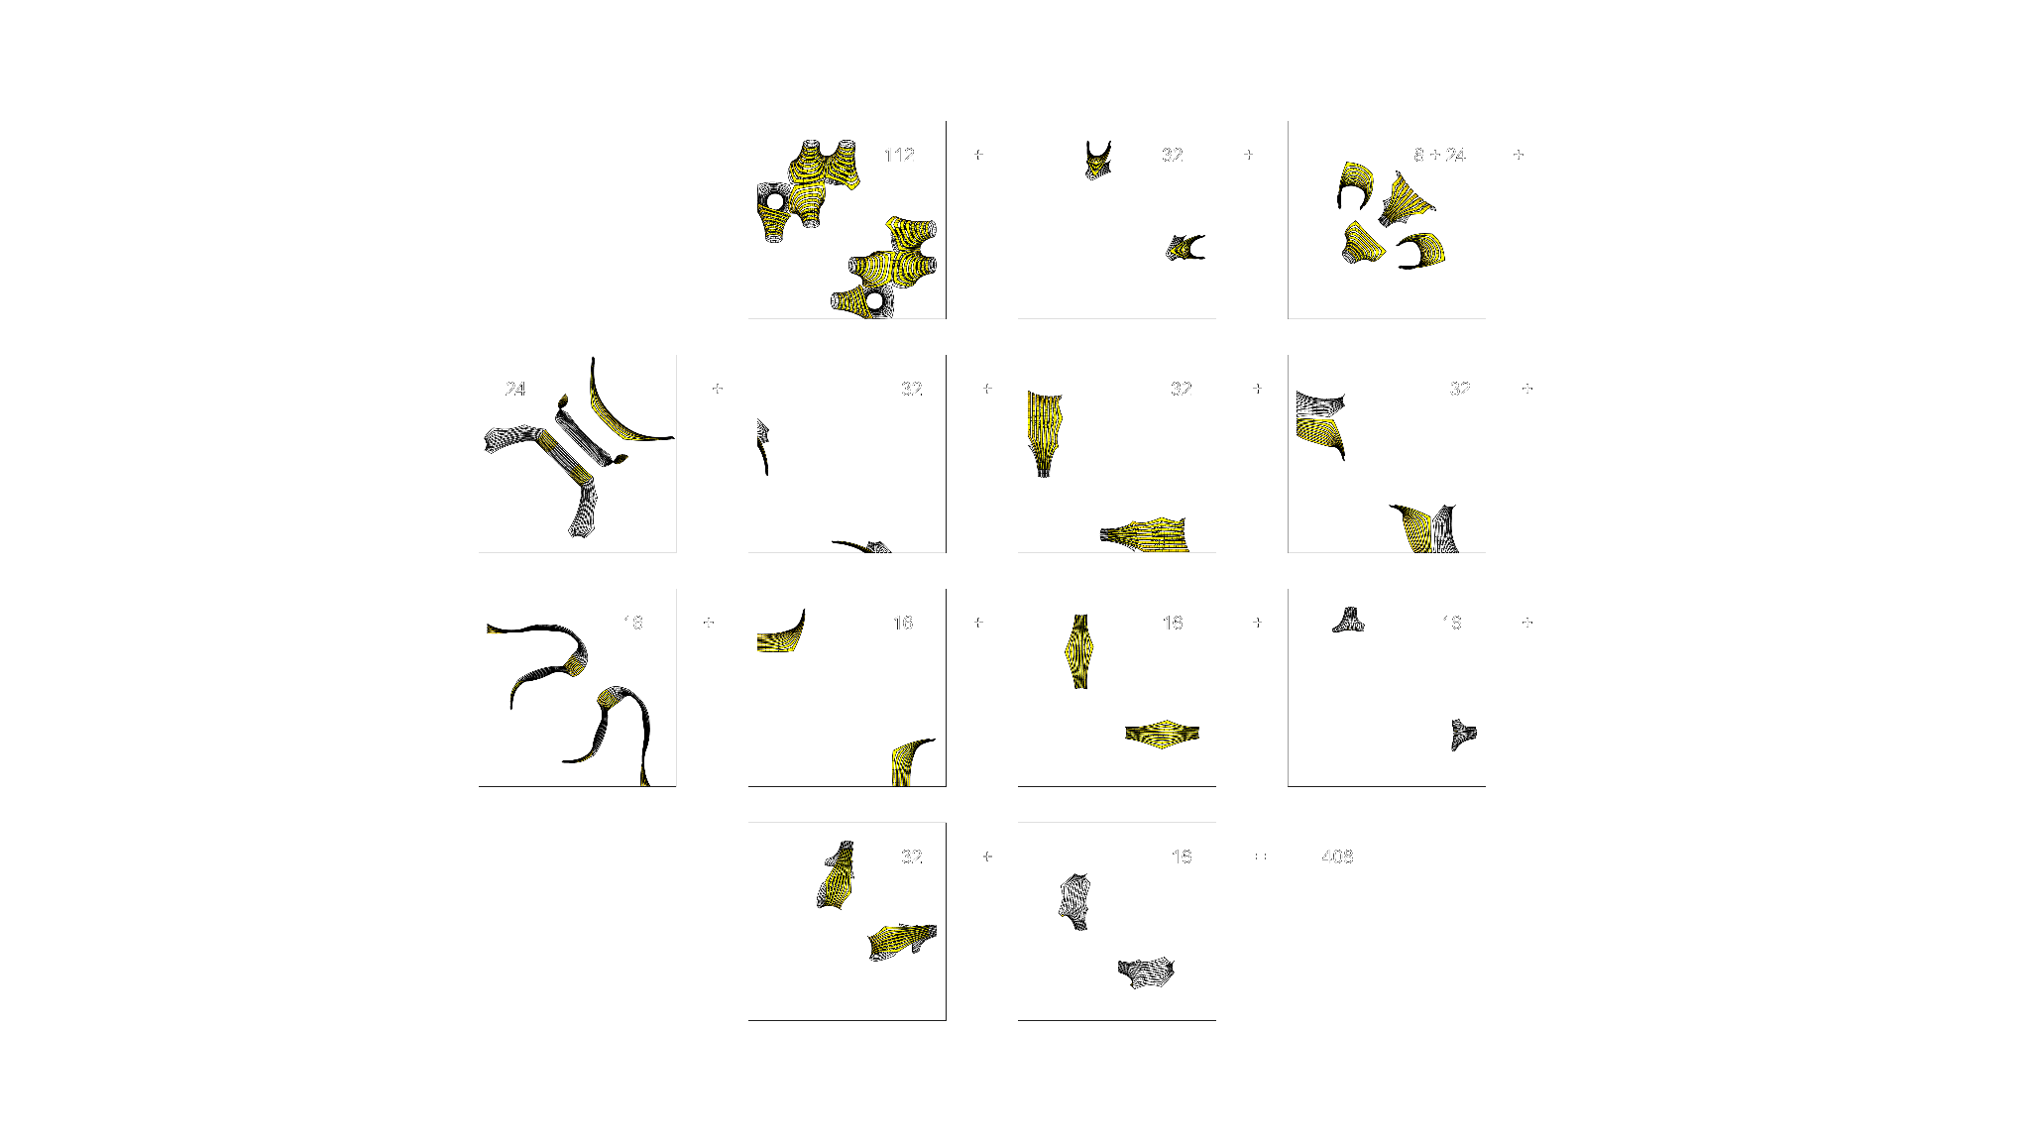
Weft Stripes Grouped

Slide 12
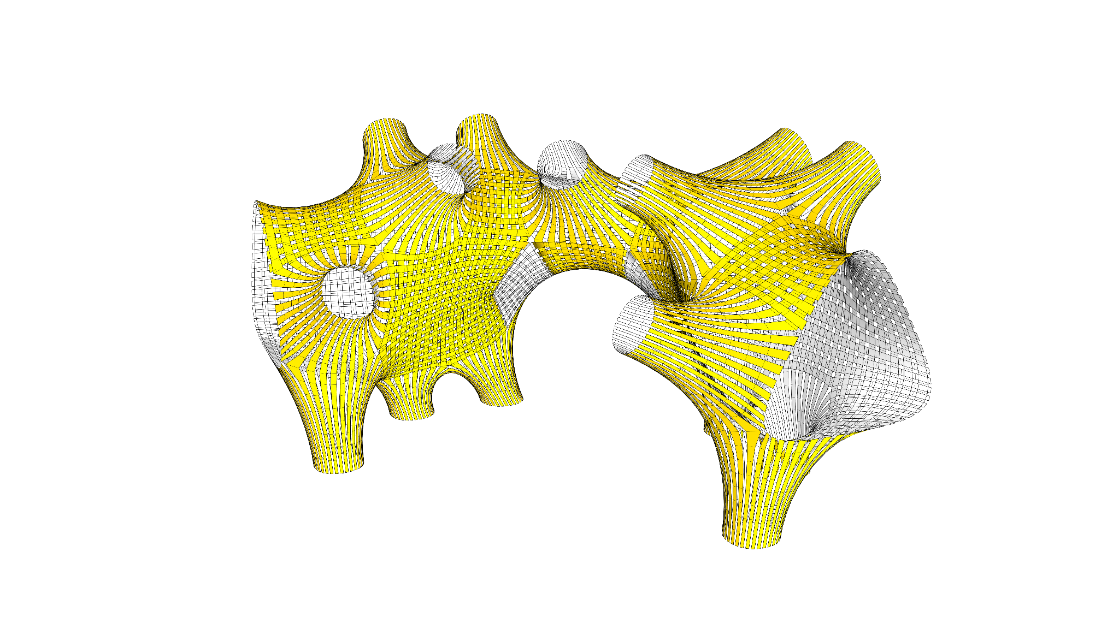
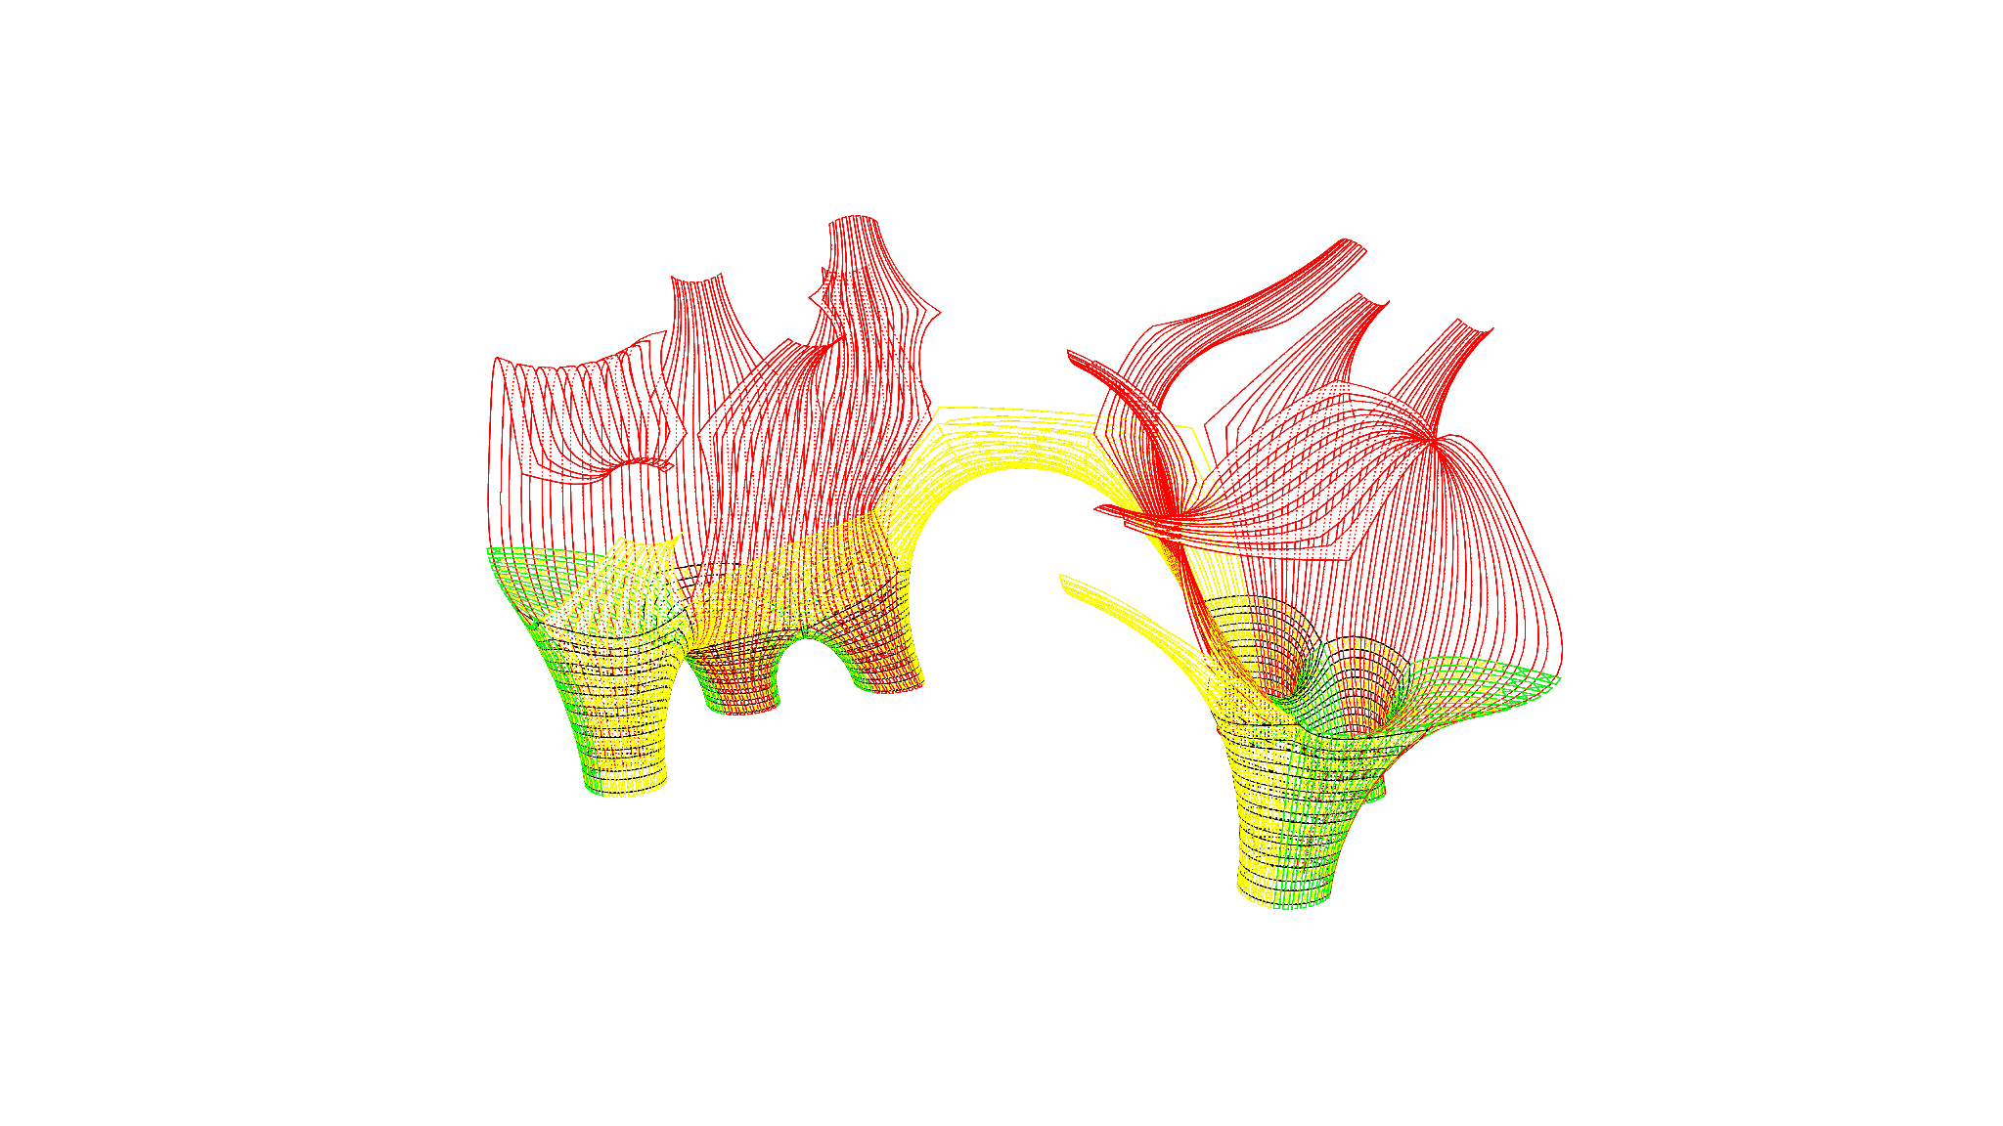
Assembly
All the strips required to complete the feet = 208.
The closed loops of the feet = 6 x 8 = 48
Short (green) open strips = 6 x 8 = 48
Medium (yellow) open strips = 4 x 8 = 32
Long (Red ) open strips = 10 x 8 = 80

Slide 13
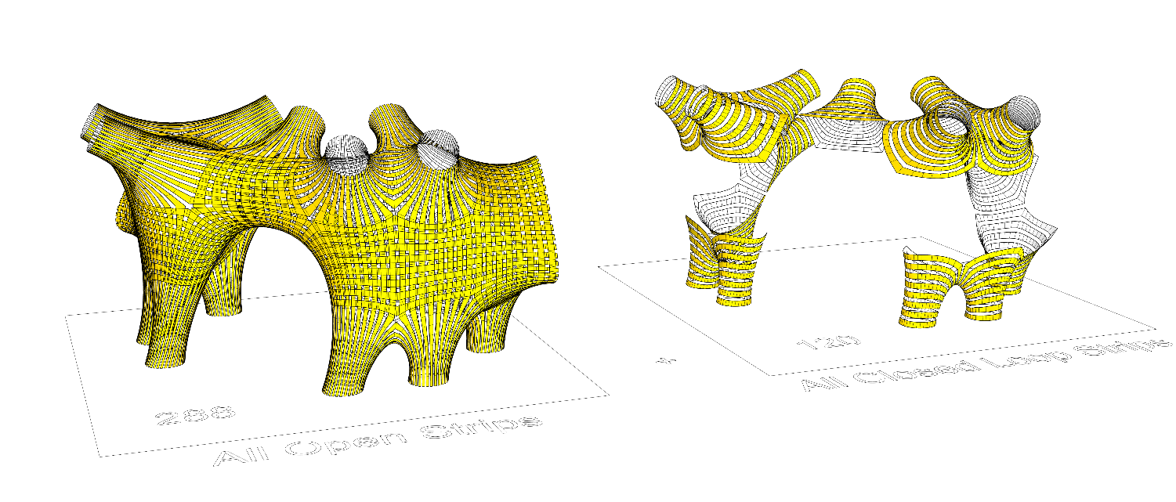
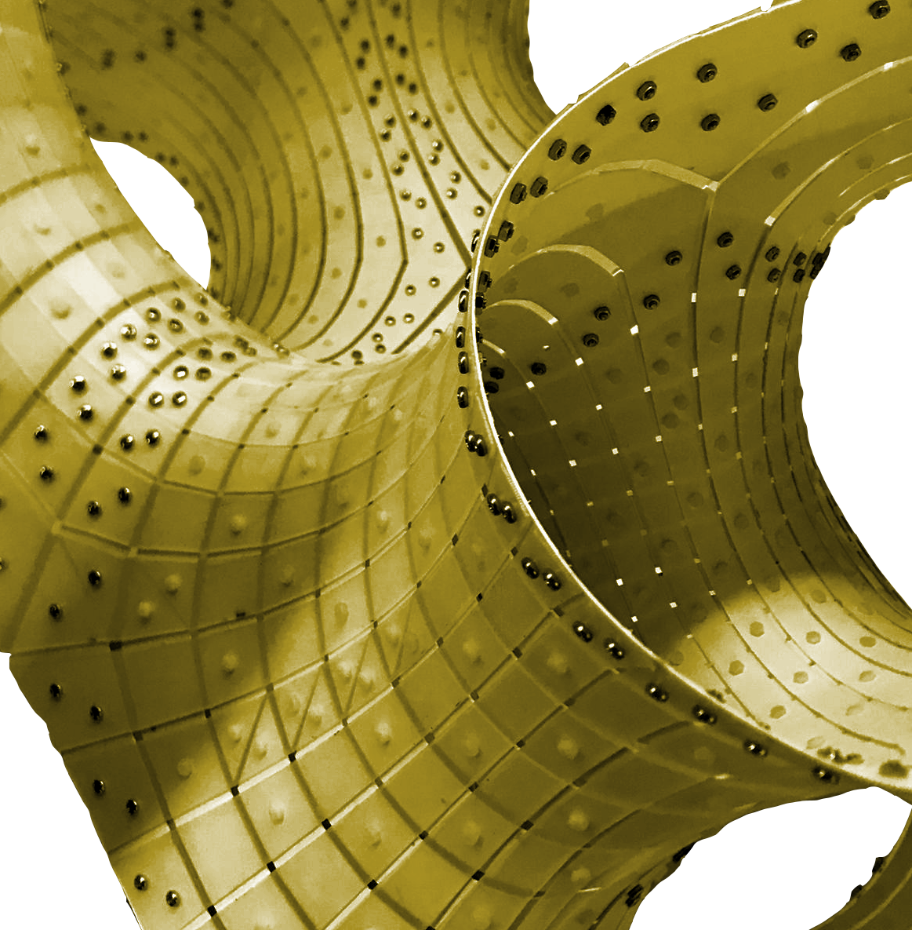
Connections
-riveting
-progressive decrease of rivets at greater height
-closed and open pieces

Slide 14
